Slide 1

A discussion on property measurement & square footage
June 2024

Slide 2


Why is measurement important?
For home sellers
& home buyers
Determining value
Comparing options
Planning space
For real estate professionals
Client centric services
Protecting personal brand
Professional obligation

Slide 3
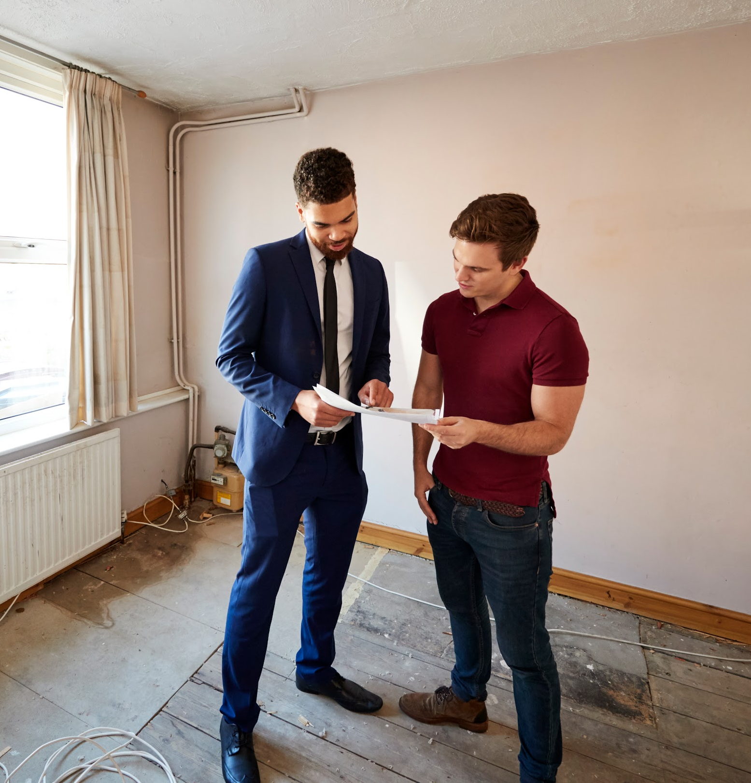
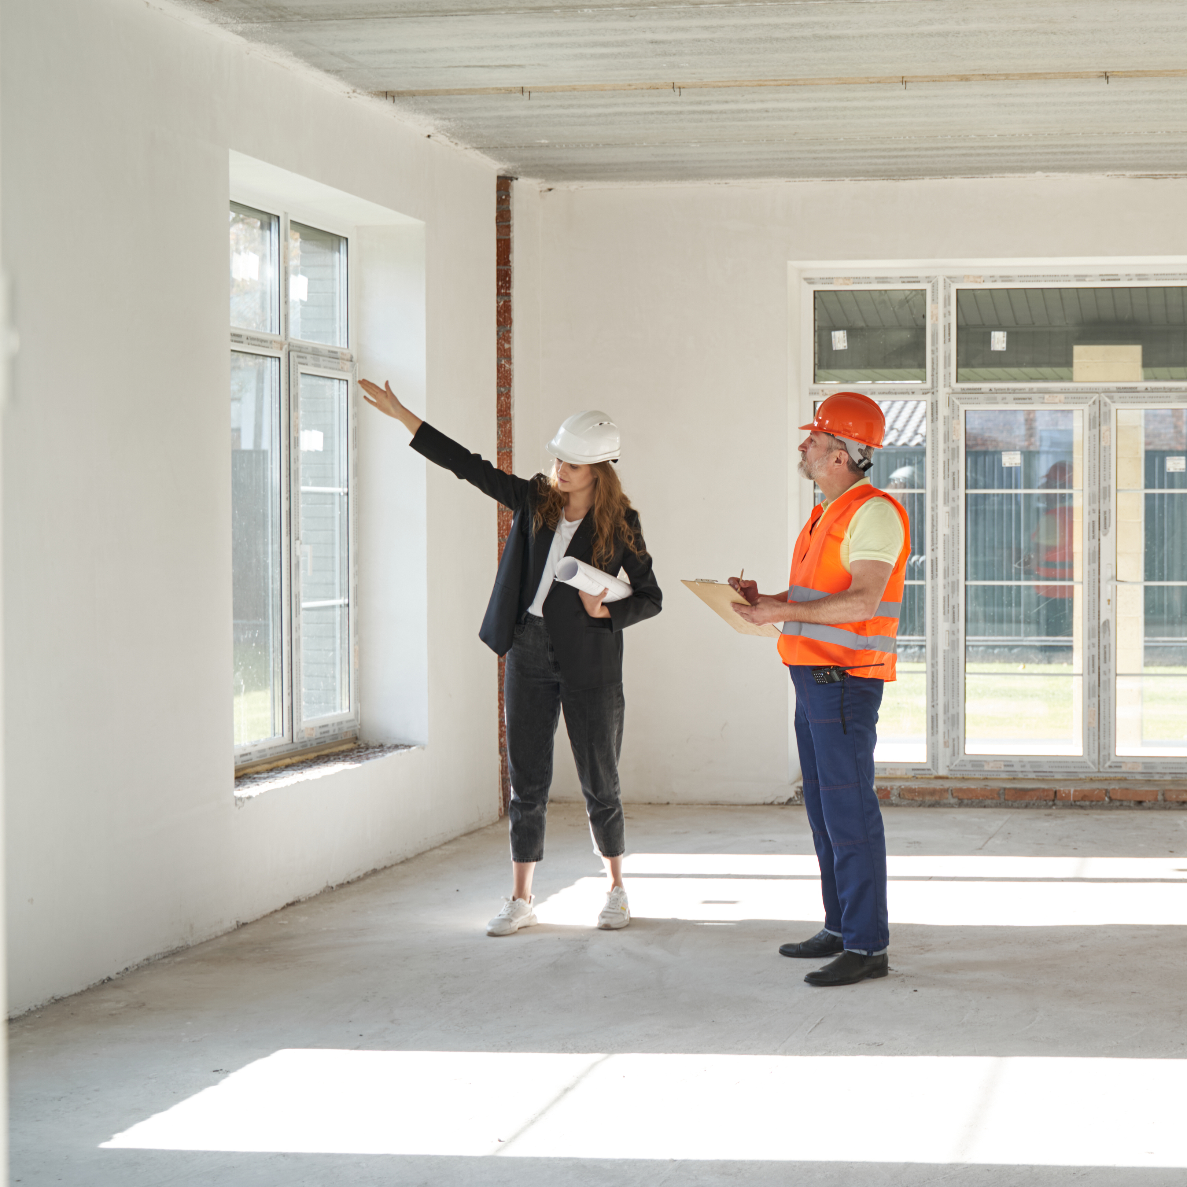
What to consider about square footage
What measurement are you giving?
What calculation are you using?
Who measured the space?
What tools were used to measure?
When was the space measured?

Slide 4
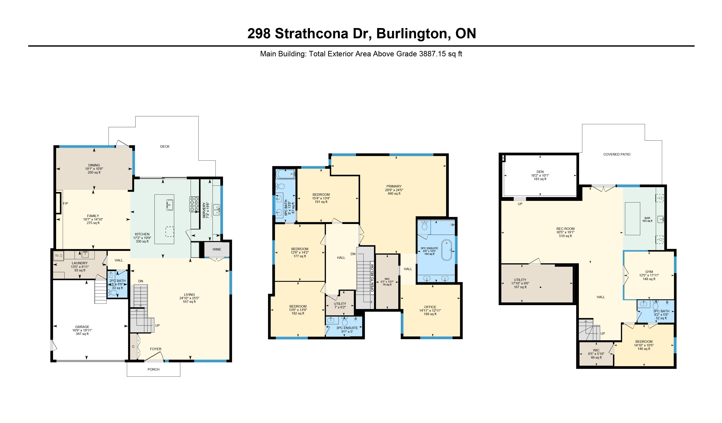
What measurement are you giving?
The power of the floor plan
Metric
Square Meter
Imperial
Square Feet

Slide 5
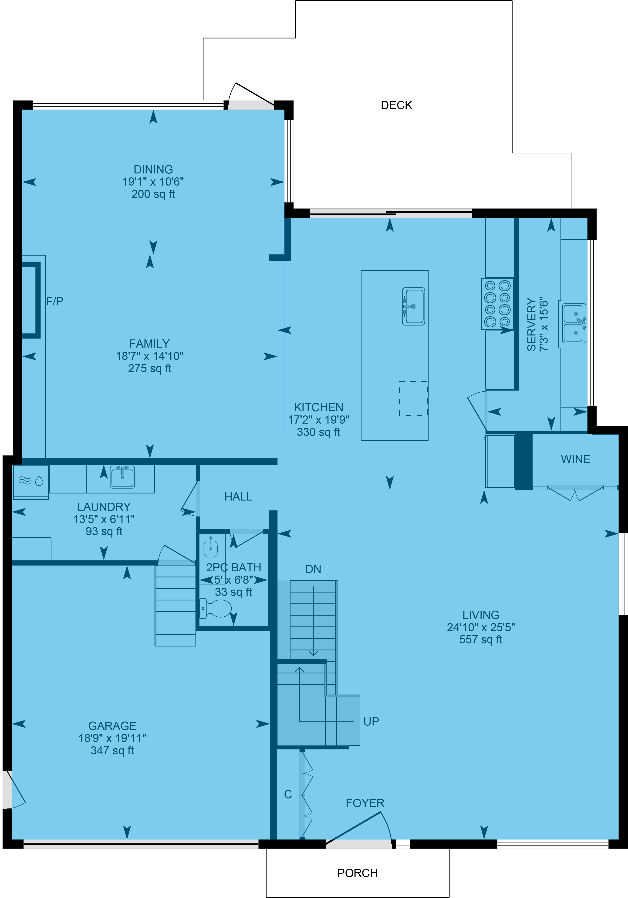
What calculation are you using?
The power of the floor plan
Interior Area
Also known as Finished Area, Living Area, Useable Area, Paint-to-Paint
For detached, single-family houses, the square footage for each level is measured to the inside of the exterior wall,
then each floor is added together to produce an exterior
area calculation.
Excluded Area
Parts of the home are not included in a total
area calculation.

Slide 6
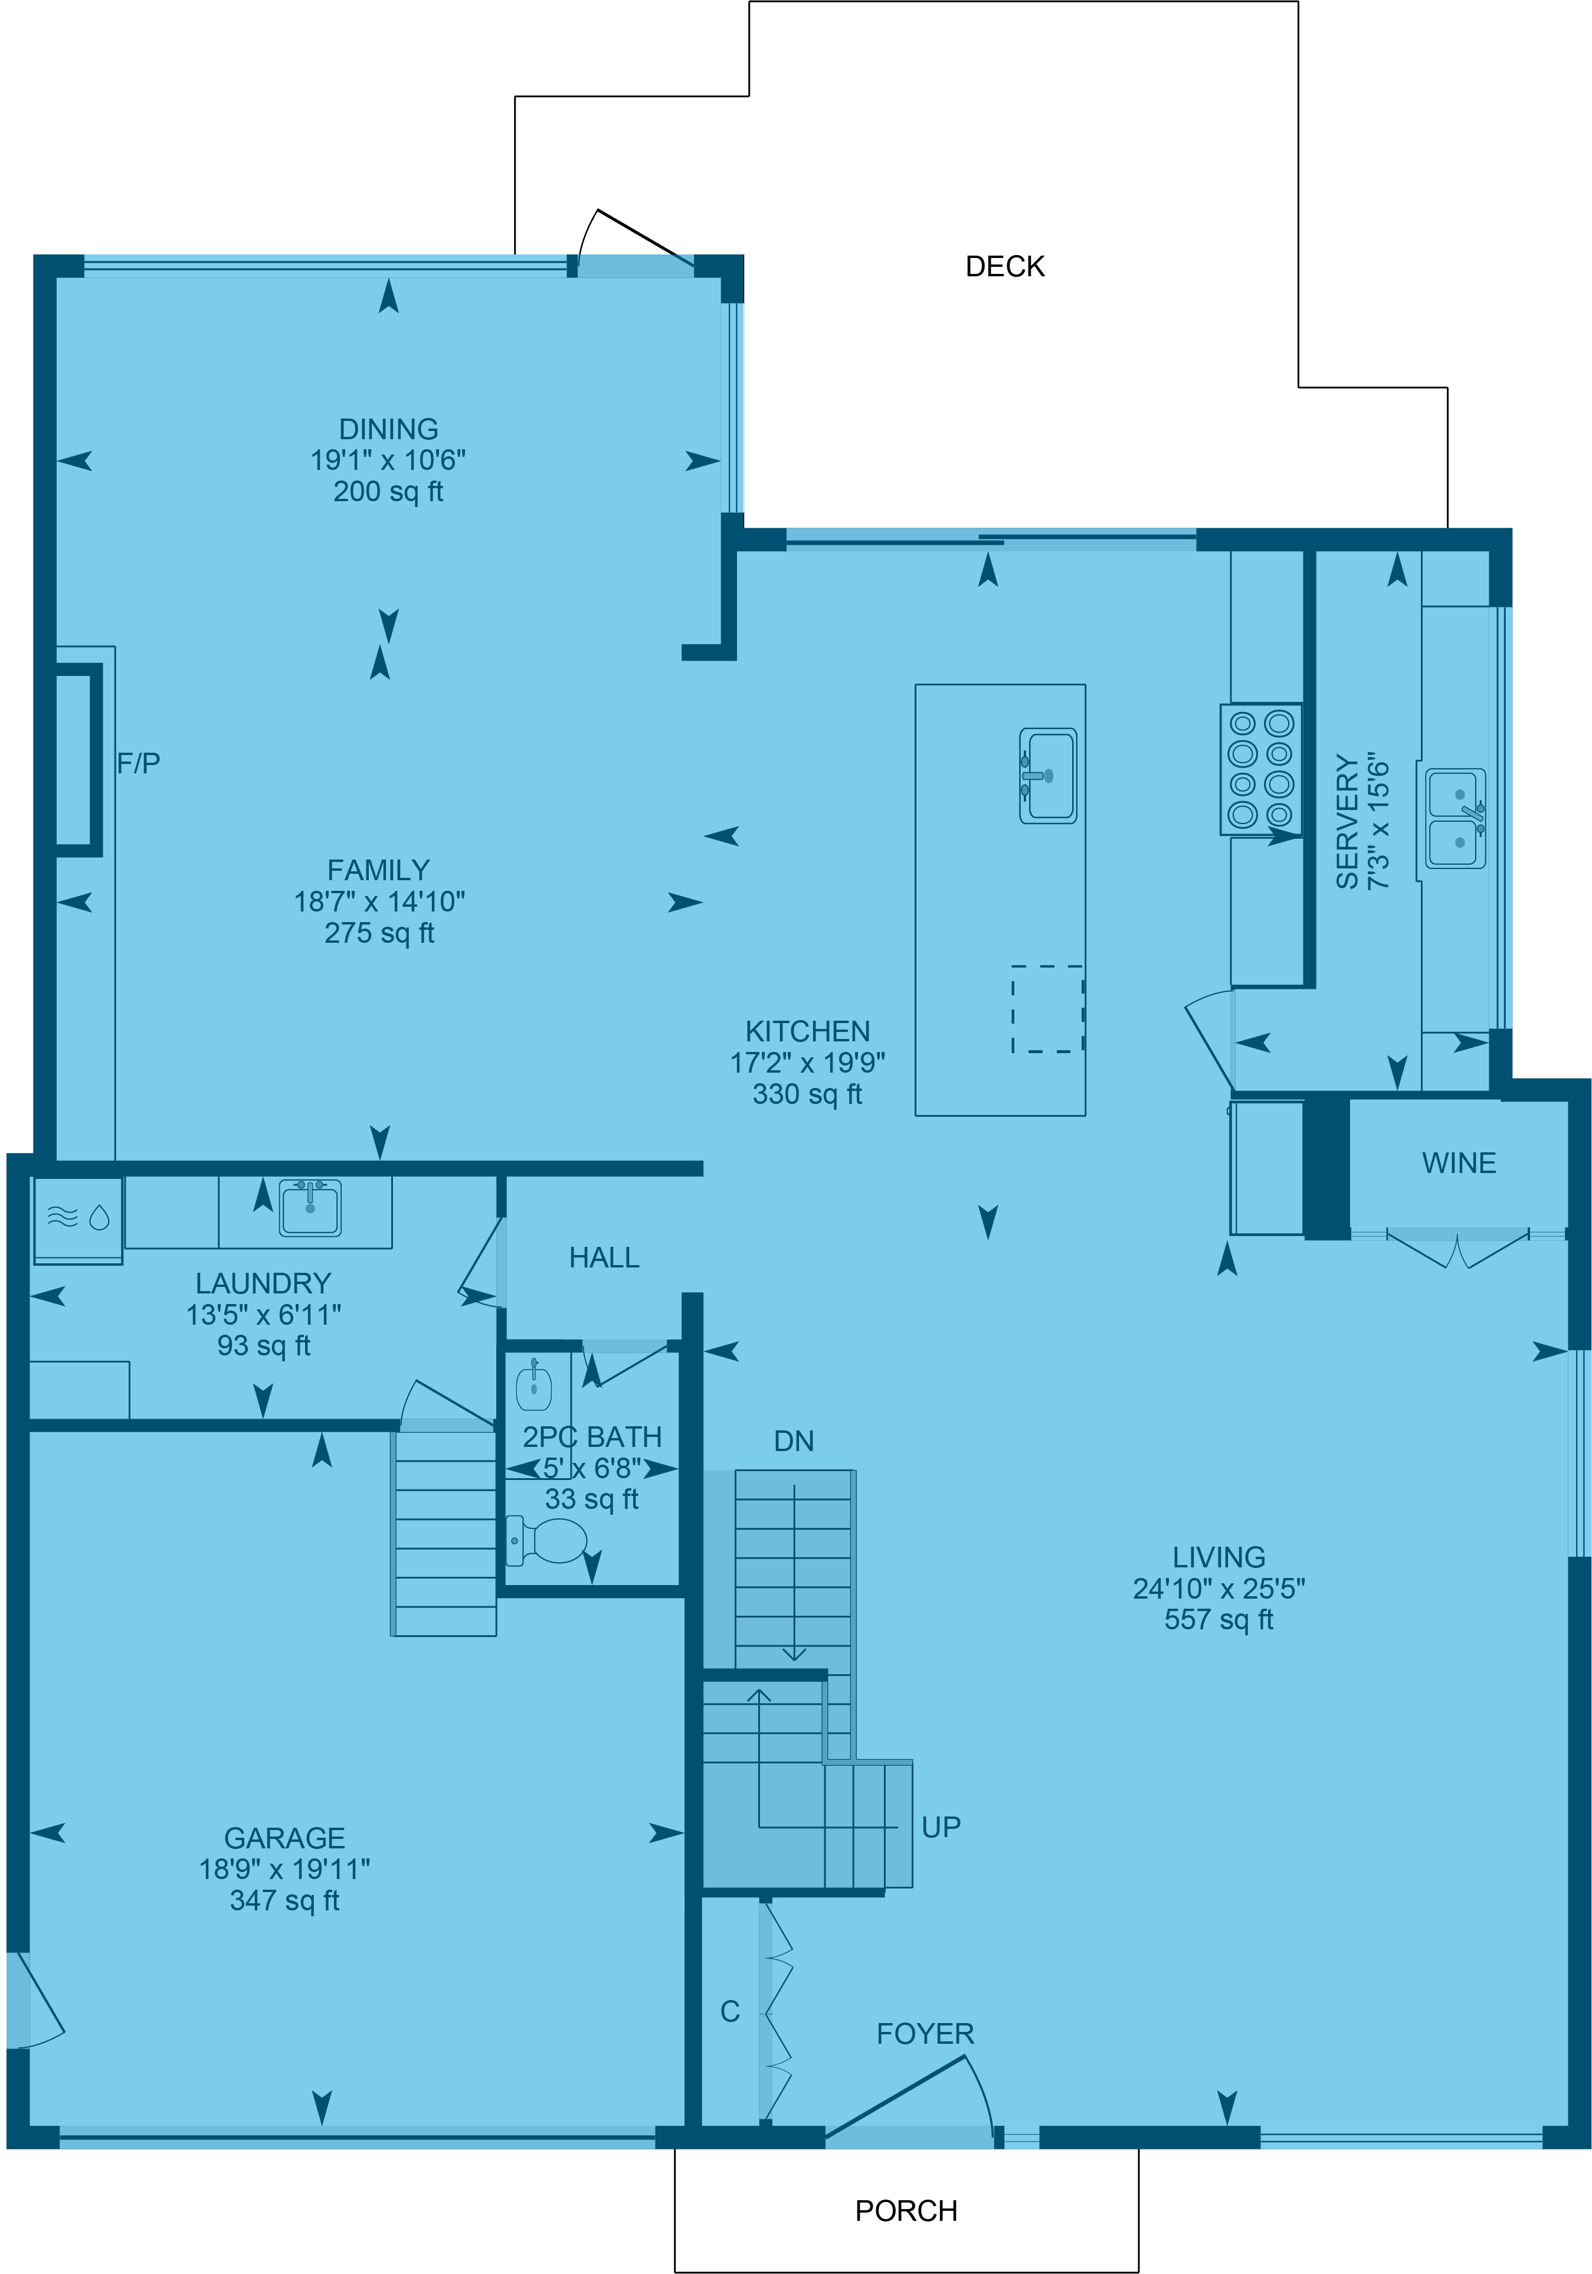
What calculation are you using?
The power of the floor plan
Exterior Area
Also known as Gross Floor Area (GFA)
For detached, single-family houses, the square footage for each level is measured to the outside of the exterior wall, then each floor is added together to produce an exterior area calculation.
Excluded Area
Parts of the home are not included in a total
area calculation.

Slide 7

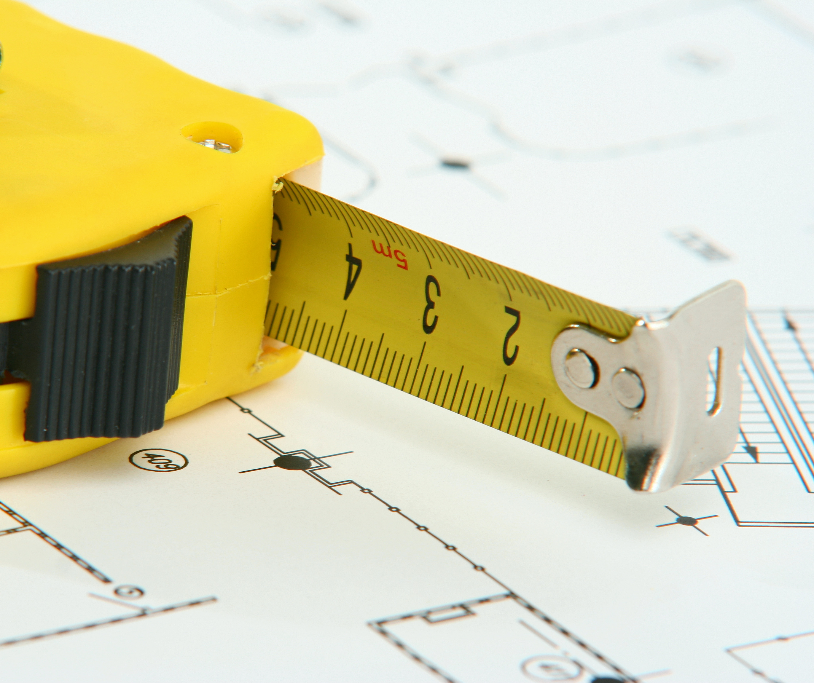
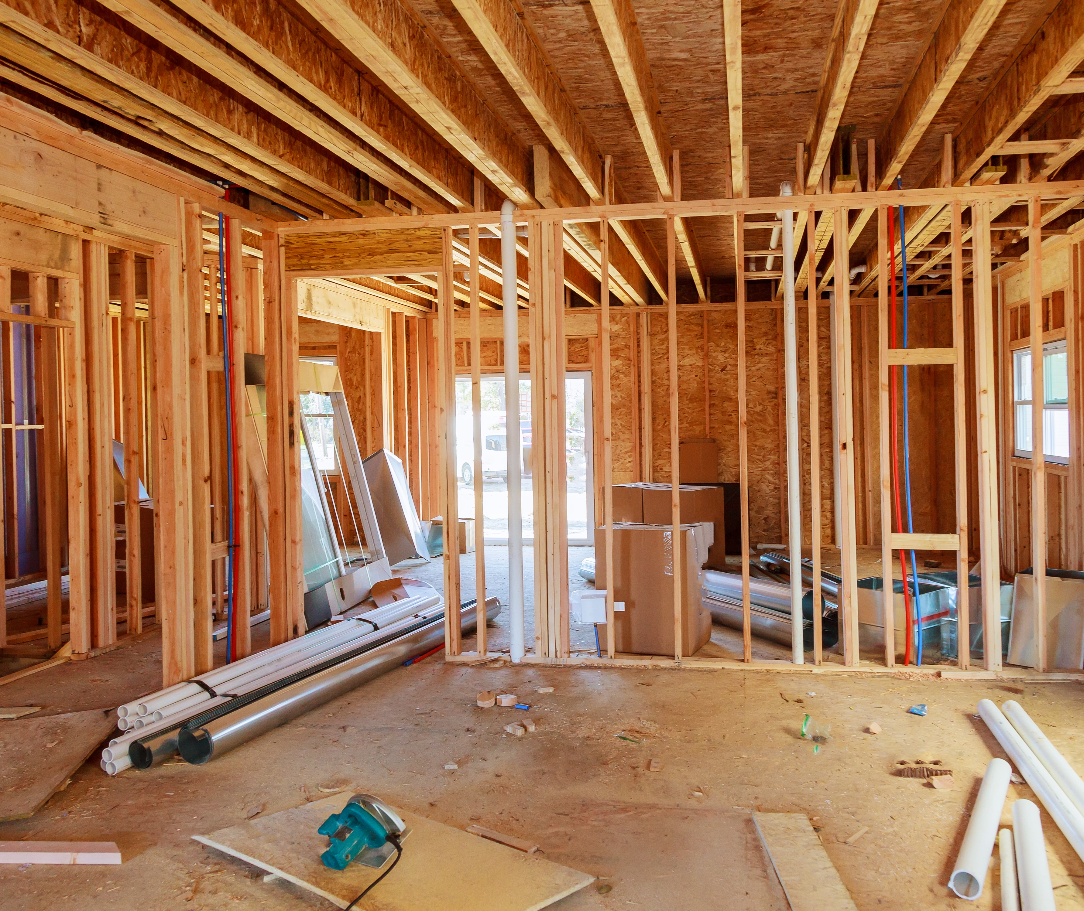
Source of
area calculations
Who measured
the space?
Builder, Property Tax Data, Owner, DIY, Measurement Professional
What tools
were used?
Tape Measure,
Measure Wheel, Laser Scan
When was the
space measured?
Pre-Construction, Post-Construction, Actual Date

Slide 8
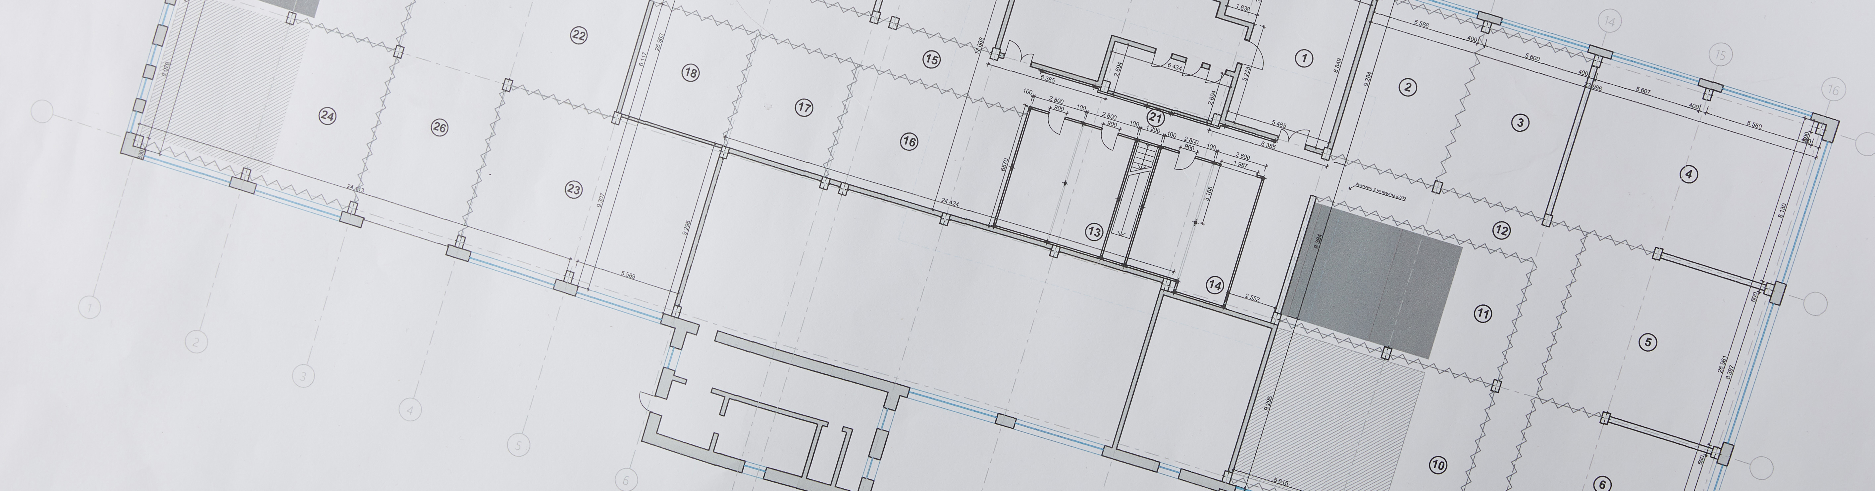
Pre-construction vs.
post-construction
Pre-construction –
As-build drawings
Floor Plans & Area Calculations produced by the design team for the purposes of completing construction. Information is subject to change during construction.
Post-construction –
As-built drawings
Record Drawings are Floor Plans & Area Calculations produced by the contractor at the completion of a construction project, reflecting all changes during construction process. As-Builts are periodically or after building modifications.

Slide 9

Knowledge is power
and defendable
Protecting yourself & your clients through documentation
Summary of room measurements
Present consistency in raw measurement data
Detailed floor area calculations
Provide the values used in calculating area
Methods of measurement
Share the method & standards applied to area calculation
Floor plan
Offer visual summary of floors with included & excluded areas

Slide 10

iGUIDE is knowledge
and power
A complete property listing tool kit
iGUIDE creates a suite of tools for organizing and sharing information
3D Virtual Tours
As-Built Floor Plans
Room Measurements
Floor Area Calculations
Photos
iGUIDE is a powerful listing
marketing technology
Tour & Floor Plans integrated in REALTOR.ca
Embed iGUIDE in your listing webpages
Add iGUIDE to your Social Marketing programs

Slide 11
Thank you
for your time

