Slide 1


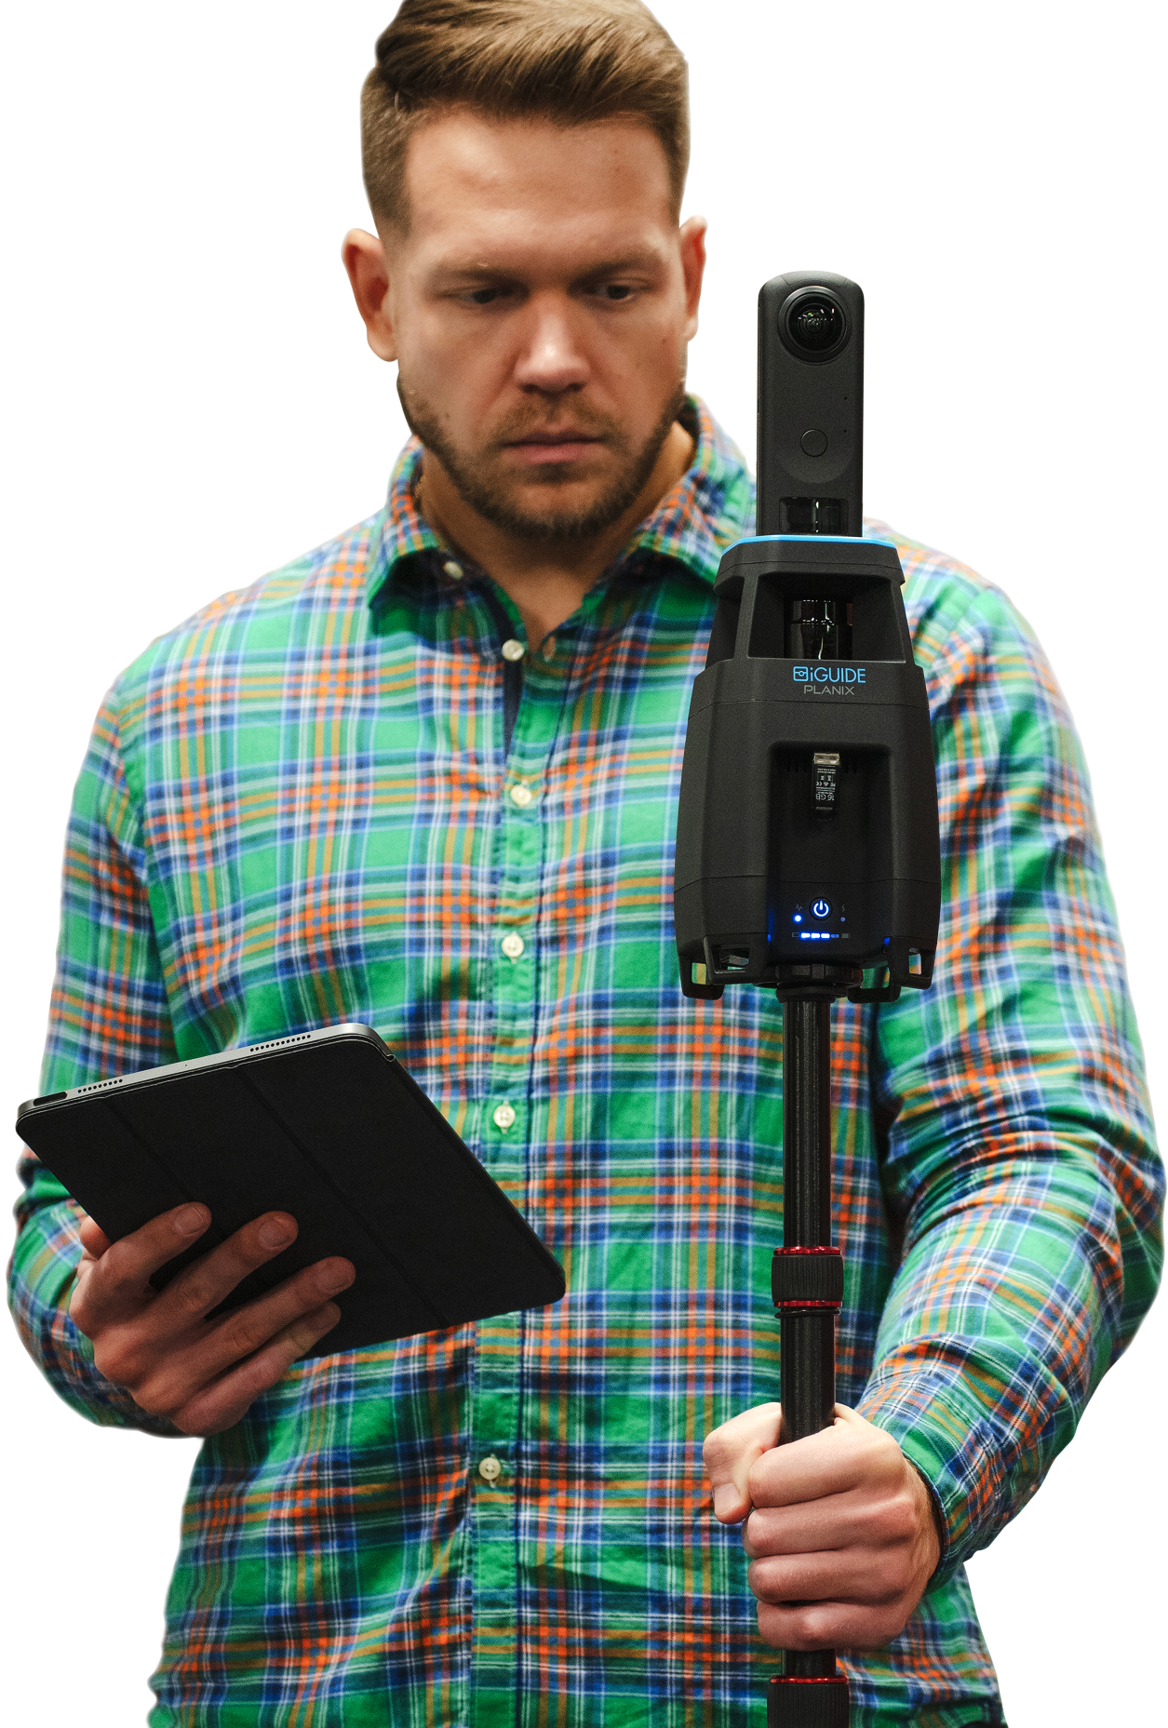

Precision meets innovation
Leaders in Building Measurement
& As-Built Documentation

Slide 2

Why iGUIDE for
full site documentation
Enhanced Speed
Take site data
collection from
weeks to days.
Improved Accuracy
Ensure measurements and drawings are
up-to-date and accurate.
Immersive Visuals
Provide your design team with 360° visualization of the space inside and out.
Streamlined
Execution
Avoid return trips to
site for missing and incorrect information.
Strengthened Collaboration
We ensure everyone
on the project team is working from the
same data set.

Slide 3
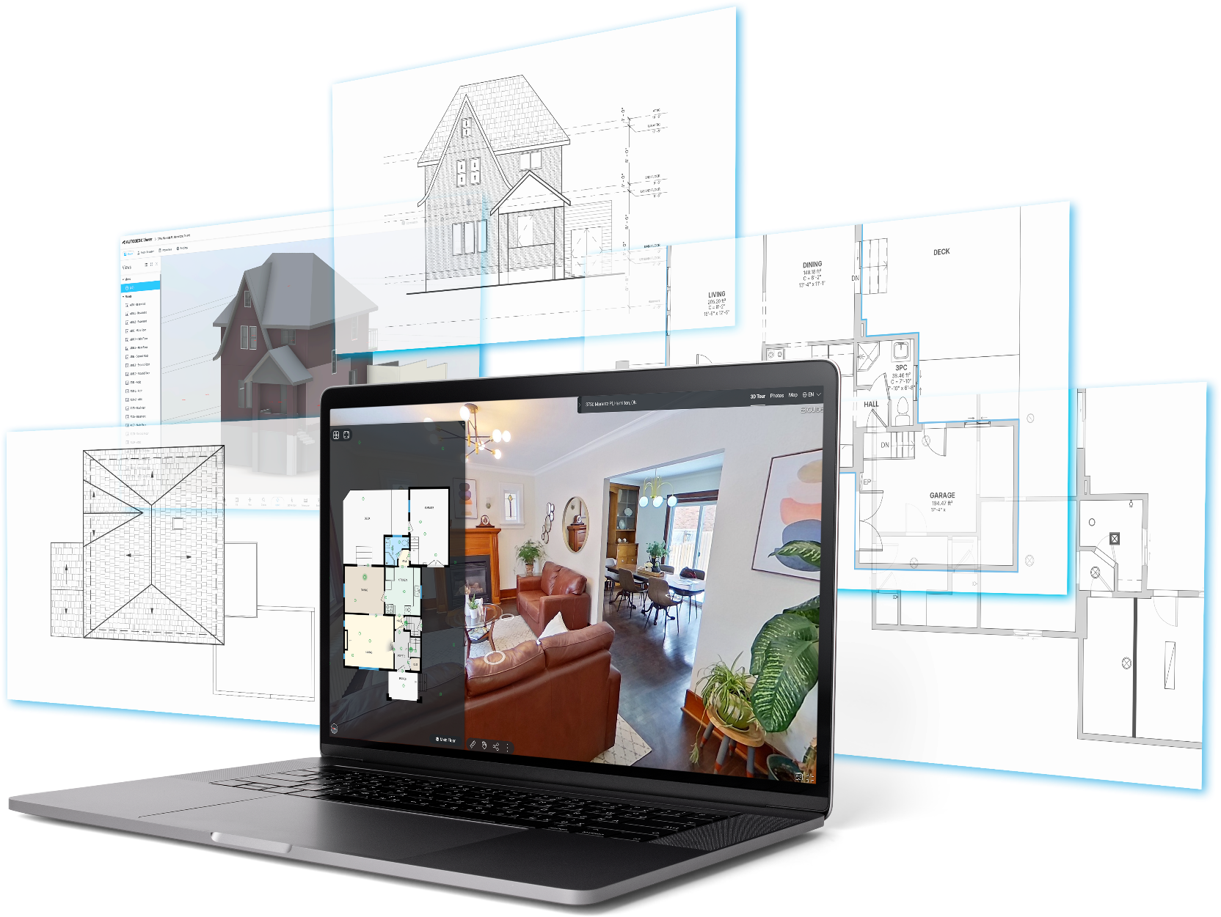



Full site documentation
package in 3 easy steps
Comprehensive
CAD Package
Kick-off
Tell us about your project (project purpose, desired elements, location) to get started.
Site Visit
Our local Field Technician will visit your site(s) to collect,
scan and document the property.
Delivery
We’ll deliver your iGUIDE Report with downloadable drawing files, photos and links to your
virtual walkthrough.

Slide 4
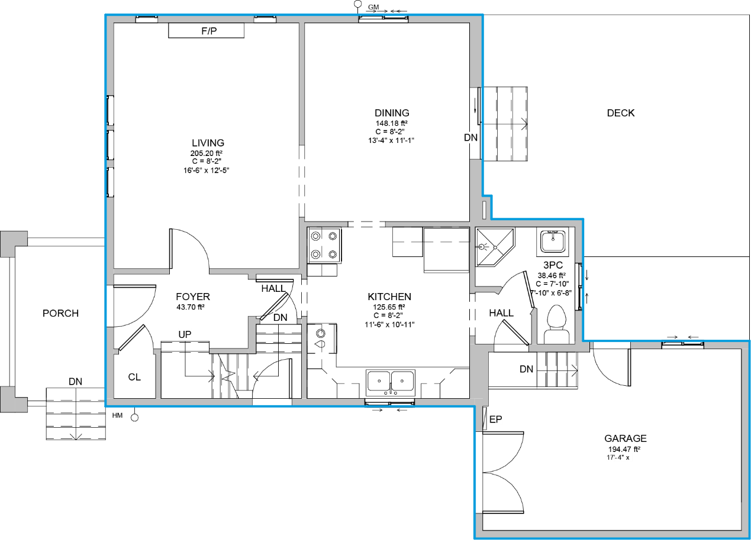

iGUIDE CAD Package
For comprehensive property understanding, each iGUIDE CAD package includes comprehensive property documentation.
As-Built Floor Plans
Dimension Plans
3D Virtual Walkthrough
Photo Tags of Building System Equipment Make,
Model and Serial information
3D CAD Package includes:
Exterior Elevation Drawings
Roof Plan
Add-on available with 2D or 3D CAD Package: Reflected Ceiling Plans
EXPLORE SAMPLE PLOT PDF
CAD FILE
RVT FILE
3D
Walk
Through

Slide 5
CAD Package Drawing Details
As-Built Floor Plan (DWG & PDF) includes:
Architectural Items
Interior & Exterior Openings
Structural Columns
Stairs, Elevators, Lifts, Ramps, Int. / Ext. Roof Ladders
Roof Hatch
General Ceiling Heights & Features
Bathroom Privacy Partitions
Exterior Patios & Decks
Millwork
Appliances
Mechanical , Electrical & Plumbing Equipment
Plumbing Fixtures
Floor Drains
Water Meter
Hot Water Heaters
Sump Pits
HVAC Rooftop and Interior Equipment
Electrical Panels
Gas Meter & Hydro Meter
Generator
3D CAD Package: 3D Model (RVT),
Exterior Elevation Drawings + Roof Plan (DWG & PDF) includes:
Architectural Items
Building Materials
Openings in Walls
Stairs & Ramps
Exterior Patios & Decks
Elevations will be created for each Customer Facing Wall
Reflected Ceiling Plan (DWG & PDF) Add-on includes:
Architectural Items
Bulkheads
Ceiling Types
Detailed Ceiling Heights & Features
Mechanical , Electrical & Plumbing Equipment
Exhaust
Supply and Return HVAC
Sprinkler Heads
Lighting

Slide 6
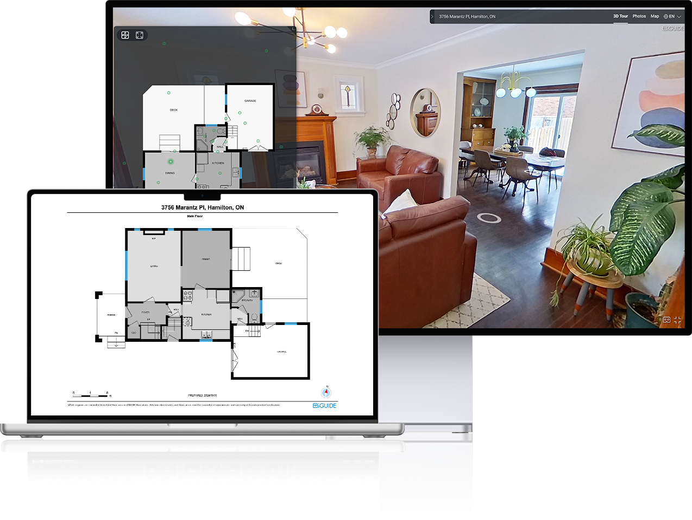

iGUIDE Premium
Provide an immersive virtual experience that lets colleagues, partners and contractors explore your
site 24/7 from any location.
What’s included…
3D Virtual walkthrough
Advanced on-screen measurements
Equipment photo tags (Make, model, serial numbers)
Detailed schematic floor plans with fixtures and appliances (PDF, JPG, SVG formats)
Room dimensions
Floor area calculations
Photo gallery & slide show
Downloadable offline file (self-hosting)

Slide 7
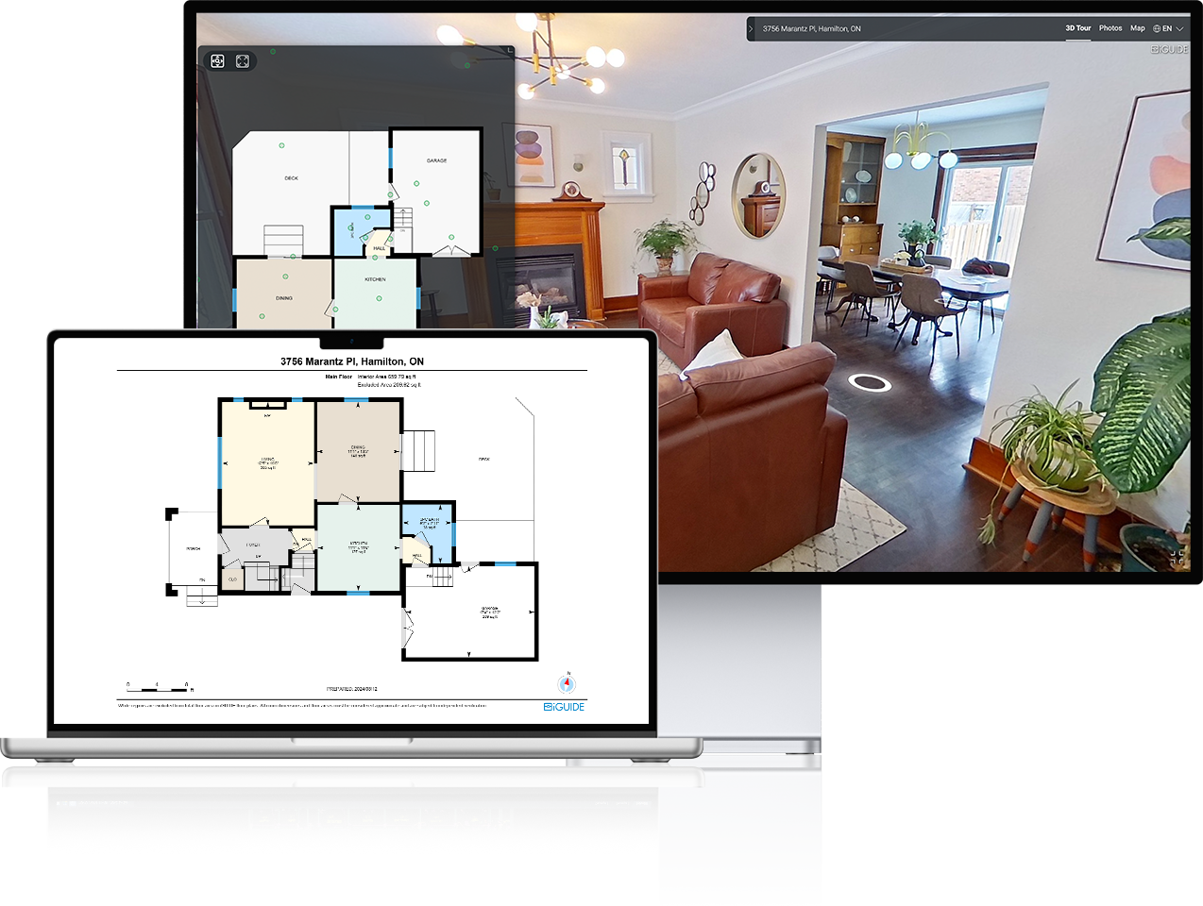
iGUIDE Standard
Provide an immersive virtual experience that lets colleagues, partners and contractors explore your
site 24/7 from any location.
What’s included…
3D Virtual walkthrough
Advanced on-screen measurements
Equipment photo tags (Make, model, serial numbers)
Schematic floor plans (PDF, JPG, SVG formats)
Room dimensions
Floor area calculations
Photo gallery & slide show
Downloadable offline file (self-hosting)

Slide 8
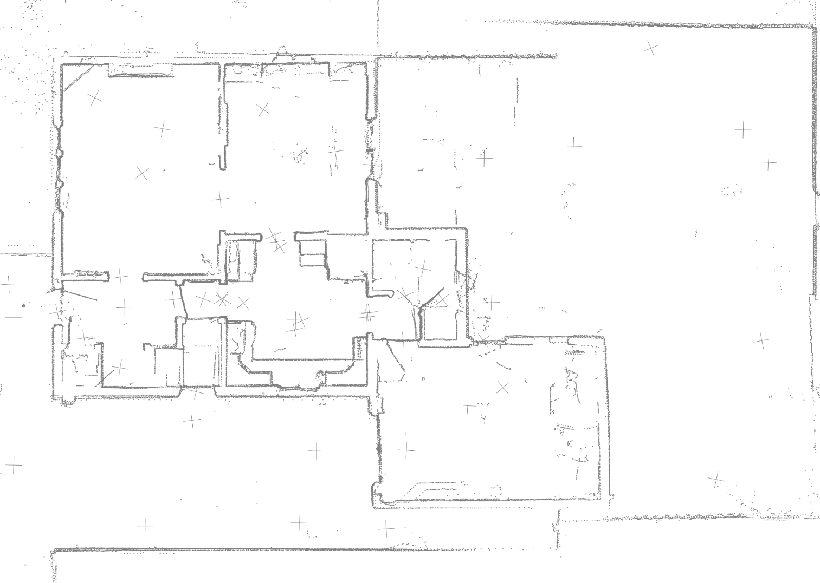
iGUIDE Radix
iGUIDE RADIX provides fast and efficient site visual documentation. The online interface with lidar point cloud is shareable and can be used to view a site and measure in 3D space.
Deliverables include:
Lidar Point Cloud (DXF)
3D Virtual walkthrough
Advanced on-screen measurements
EXPLORE SAMPLE RADIX WALK THROUGH

Slide 9






Your project.
Your data.
Data ownership
Rest assured you own
the data from each of
your projects.
No recurring fees
Pay for your project with
no additional subscription
fees attached.
Hosting flexibility
We can host your project
at no cost or download
and host yourself.
Data protection
Our information security
program incorporates control principles from SOC 2.

Slide 10
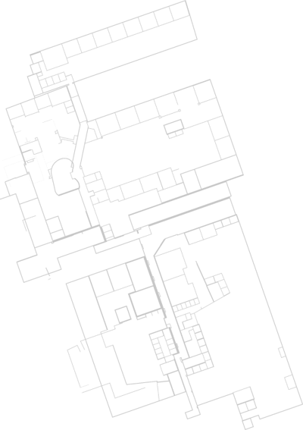
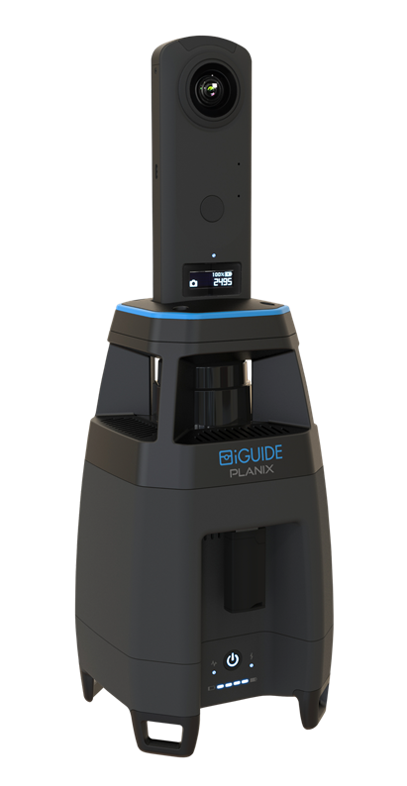
iGUIDE PLANIX Product Specifications
Lidar Measurements Range: Up to 40m (approx. 131’)
Lidar Measurement Uncertainty: +/- 1cm (approx. 0.4″) up to max range
(typical, based on at least 60cm (approx. 23.6″) wide wall segment)
Lidar Field of View: 360 degrees
Type of Lidar: Time of flight
360° Camera: Ricoh THETA Z1
Output Resolution: 26 Megapixels
WIFI: 802.11 2.4GHz/5GHz Access Point
Software: Planitar web app in a web browser over Wi-Fi from any device
System Battery: 7.5V 6.9Ah/47.7Wh Li-Ion, user-replaceable
System Power Supply: Input – 100-240VAC, 50-60Hz, 1.0A; Output – 12VDC, 3.3A
System Battery Performance: 7 hours of typical operation
System Unit Weight: 980g (2.16lbs)
System Unit Dimensions: W: 11cm (4.3″) x D: 11cm (4.3″) x H: 34cm (13.4″)
Carrying Case Dimensions: W: 39cm (15.4″) x D: 29cm (11.2″) x H: 17cm (6.7″)
Tripod Mounting Thread: 1/4-20
Operating Temperature Range: 0-40 degrees C (32-104 degrees F)
Storage Temperature Range: -20-50 degrees C (-4-122 degrees F)
The iGUIDE
PLANIX Camera captures 1000s of measurements
with each scan

Slide 11

Package Pricing ($CAD/$USD)
Deliverable​ | Cost​
2D CAD Package​ | Up to XX sq ft = $XX
 | Over XX sq ft = $XX per sq ft​
3D CAD Package​ | Up to XX sq ft = $XX
 | Over XX sq ft = $XX per sq ft​
Reflected Ceiling Plans | $XX per sq ft

Slide 12
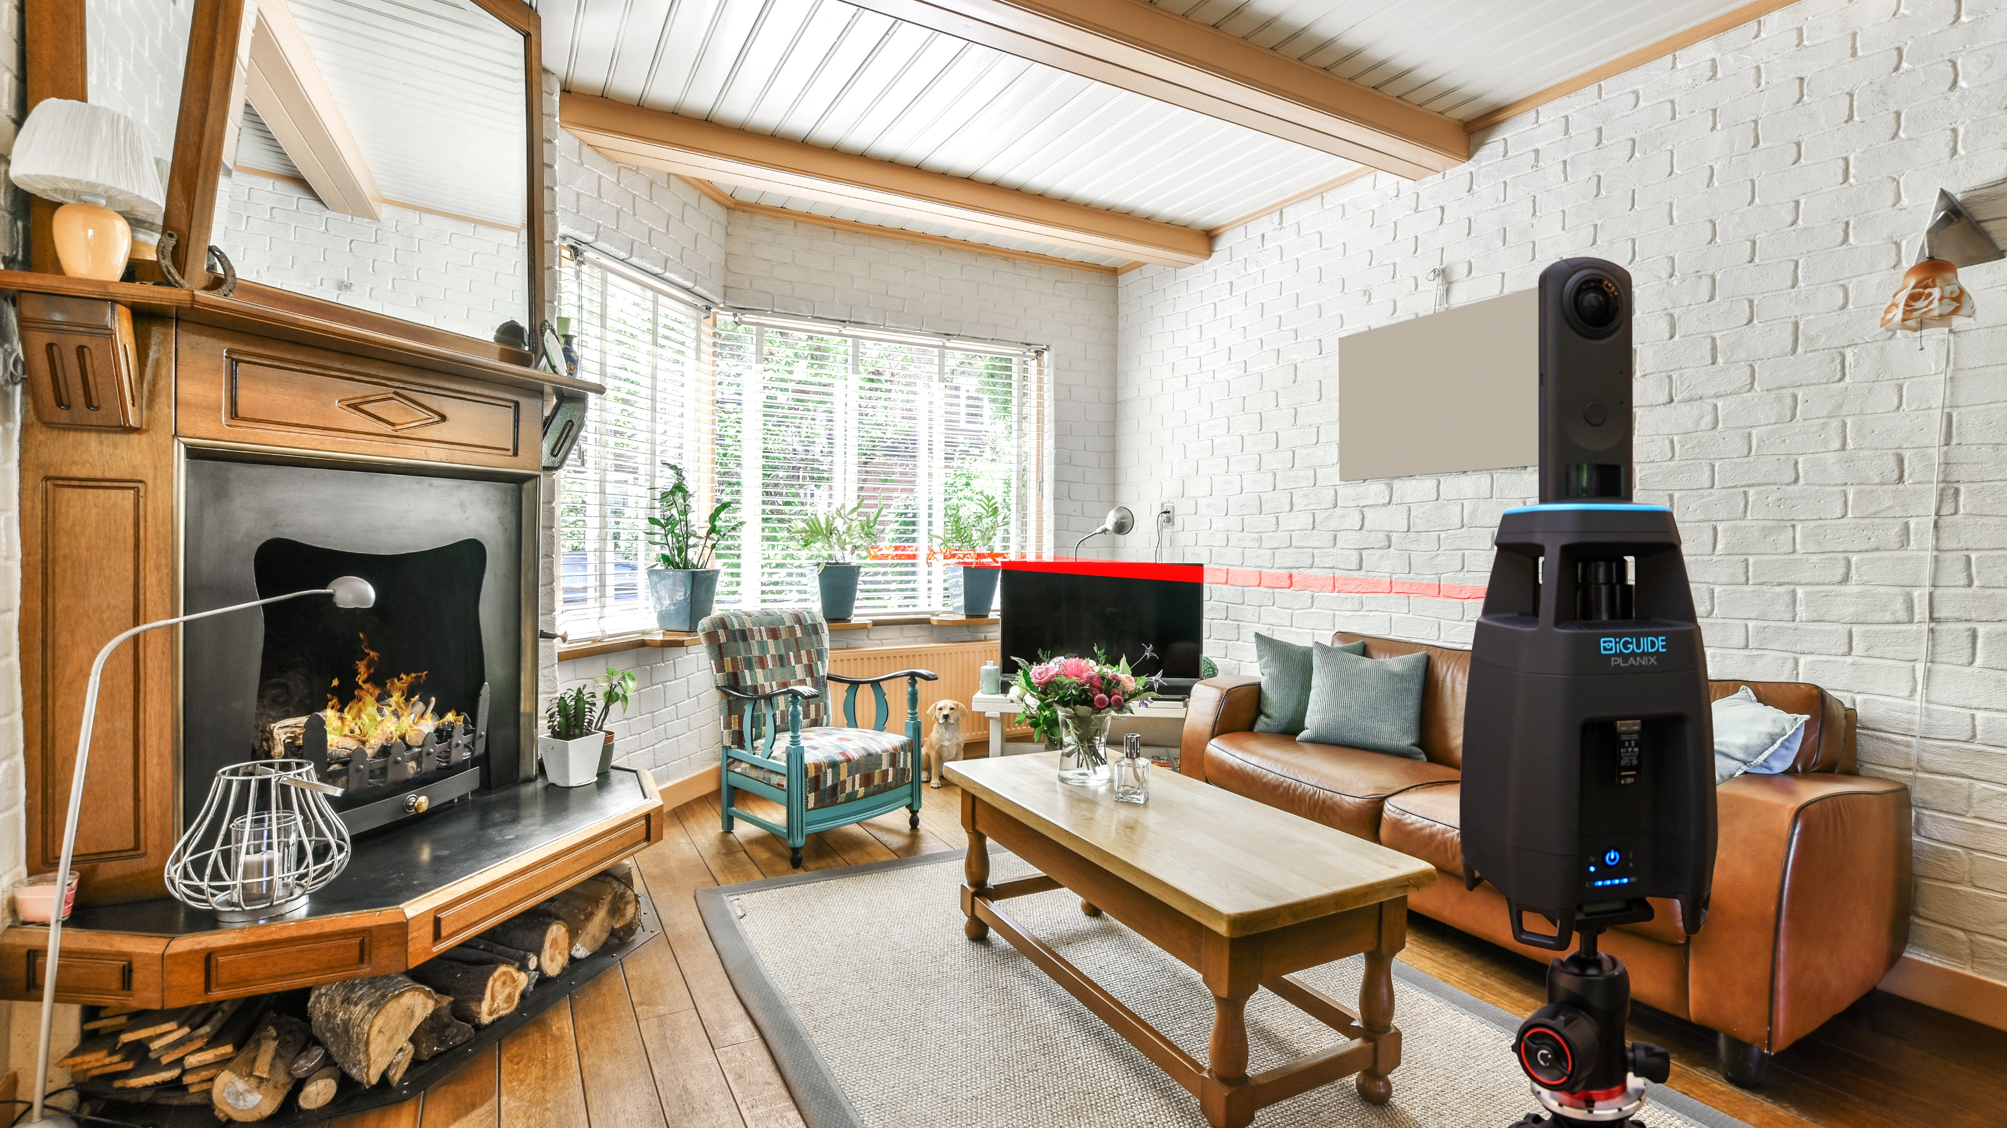
Let’s get started
Insert headshot
First Last Name
Company name
M. 123-456-4567
E. first.lastname@email.com

